Slide 1
SaLES PERFORMANCE DASHBOARD
GIWA KAUSARAT MOJOYINOLA

Slide 2
DataSET OVERVIEW
The Superstore Sales dataset contains historical sales transactions from a retail business.
It includes information on orders, customers, products, sales, profit, quantity sold, shipping methods, geographic locations, and order dates.
The dataset was explored to understand its structure, identify relevant business metrics, and create meaningful visual reports.
Purpose of the Analysis
The objective of this project is to analyze sales performance, identify business trends, evaluate profitability, and create an interactive dashboard that supports data-driven decision-making.

Slide 3
BUSINESS pROBLEM
The organization needs a dashboard that can answer important business questions such as:
Which region generates the highest sales?
Which product category is the most profitable?
Who are the top customers?
Which customer segment contributes the most revenue?
How have sales changed over time?
Which shipping method is most frequently used?

Slide 4
Key performance indicator(kpi) defined
KPI | INDICATOR
Total Revenue | 2,297,201
Total Profit | 286,397
Total Order | 5009
Profit Margin | 12.47%
Units Sold | 37873

Slide 5
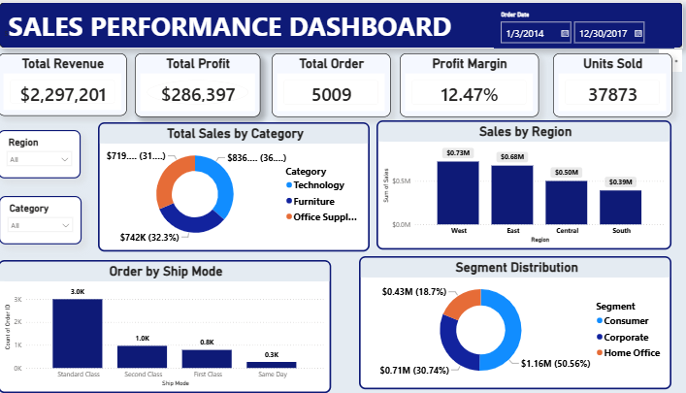

Slide 6
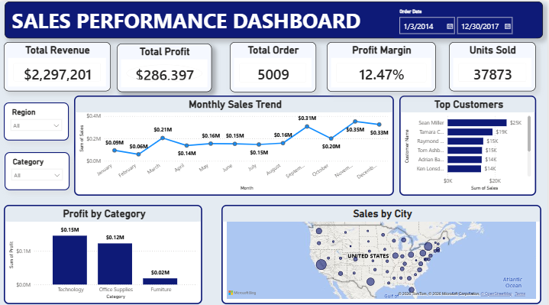

Slide 7
Key insights
Technology generated the highest sales and profit among all product categories.
The West region recorded the highest revenue, followed by the East region.
Consumer customers contributed the largest share of total sales.
Standard Class was the most frequently used shipping method.
Sales fluctuated throughout the year, indicating seasonal purchasing patterns.
Furniture generated lower profit compared to Technology and Office Supplies, suggesting opportunities for improvement.

Slide 8
Recommendations
Increase investment in the Technology category due to its strong profitability.
Develop targeted marketing campaigns for lower-performing regions to improve sales.
Investigate why Furniture has lower profitability and review pricing or operational costs.
Continue promoting Standard Class shipping while improving delivery efficiency.
Monitor monthly sales trends to better prepare for seasonal demand.

Slide 9
Conclusion
This project successfully transformed raw sales data into an interactive Power BI dashboard that provides meaningful business insights.
Through KPI analysis, interactive visualizations, and data storytelling, the dashboard enables stakeholders to monitor sales performance, identify growth opportunities, and make informed business decisions.

